Slide 1

NCHRP Report 956: TAM Data and Information System Assessment
Assessment Results and Action Plan

Slide 2
Agenda
Presentation Material:
Assessment Overview
Key Assessment Outcomes and Recommendations
Implementation Action Plans

Slide 3
Assessment Overview
Approach-Specific Overview
Approach-Specific Context by Assessment Area

Slide 4

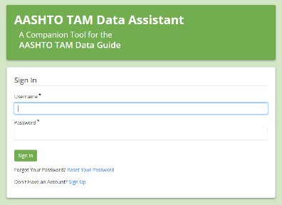
TAM Data and Information System Assessment
NCHRP Project 08-115: Report 956
Developed data self-assessment and improvement methodology and tools
Guidance provided by NCHRP Report 956
Web-based version provided by AASHTO: www.tamdataguide.com
AASHTO TAM Data Assistant
A supporting, web-based tool provided by AASHTO: www.dataassessment.tam-portal.com
4

Slide 5
<Assessment Name>
Assessment Context
<describe targeted asset program, data area, or other context>
Assessment Objective
Benchmark current and desired data collection, processing, and decision-support capabilities
Identify opportunities to improve supporting data, processes, and tools
Document assessment outcomes and high-level action plan to support implementation

Slide 6
Assessment Team
Core Team
Sponsor:
<name, position>
Business Lead(s):
<name, position>
<name, position>
Facilitator(s):
<name, position>
General Participants
Subject Matter Experts:
  <name, position>
  <name, position>
  <name, position>
Field Representatives:
  <name, position>
  <name, position>
  <name, position>
Consulted:
<name, position>
<name, position>
<name, position>
<name, position>

Slide 7
High-Level Assessment Approach
1
Kickoff Meeting
Set scope, schedule, expectations (60 min)
3
Improvement Eval
Core team consolidates improvements
Improvement Evaluation Meeting (90 min)
  Discuss potential improvement priorities
  Evaluate potential organizational challenges
Core team drafts assessment themes/actions
2
Benchmarking
Offline Individual Assessments
  Completed by <DD/MM>
Group Assessment Meeting 1 (60-90 min)
  <Anticipated Discussion Areas/Topics>
Group Assessment Meeting 2 (60-90 min)
  <Anticipated Discussion Areas/Topics>
Group Assessment Meeting 3 (60-90 min)
  <Anticipated Discussion Areas/Topics>
4
Action Planning
Summary & Planning Meeting (60-90 min)
  Confirm assessment themes
  Explore proposed implementation actions
5
Closeout
Assessment Closeout Meeting (60-90 min)
  Finalize plan, set responsibilities/timelines
Assessment Summary Materials finalized

Slide 8
Assessment Summary
Area Overviews
Key Themes

Slide 9
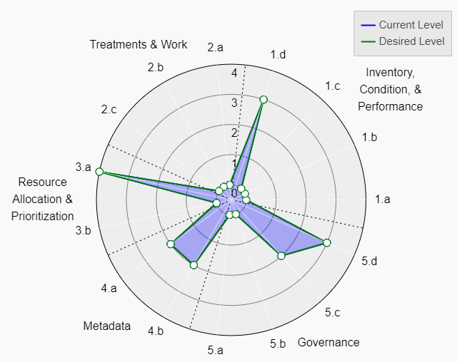
Area A: Specify and Standardize Data
Area Description:
Alignment of asset data req. & needs
Standardization of data models for integration, analysis, and reporting
Formalization of prioritization & allocation methodologies
General Assessment Summary:
<insert 1-3 key themes>
General Improvement Recommendations:
<insert 0-3 key improvements
Placeholder
Replace with Radar Chart from TAM Data Assistant

Slide 10
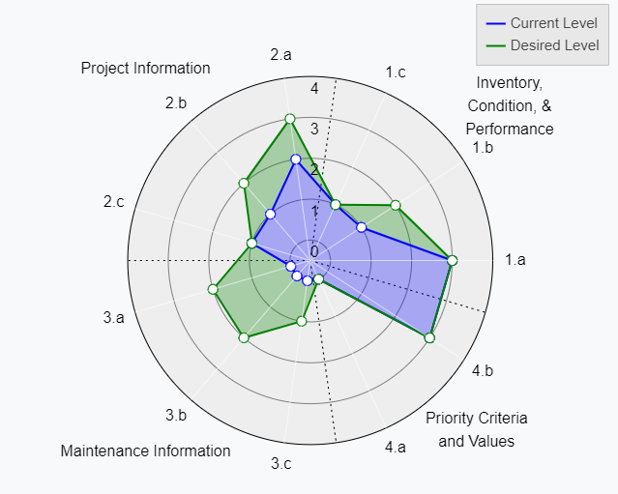
Area B: Collect Data
Area Description:
Align/advance methods for collecting and assuring quality for key TAM related data
General Assessment Summary:
<insert 1-3 key themes>
General Improvement Recommendations:
<insert 0-3 key improvements
Placeholder
Replace with Radar Chart from TAM Data Assistant

Slide 11
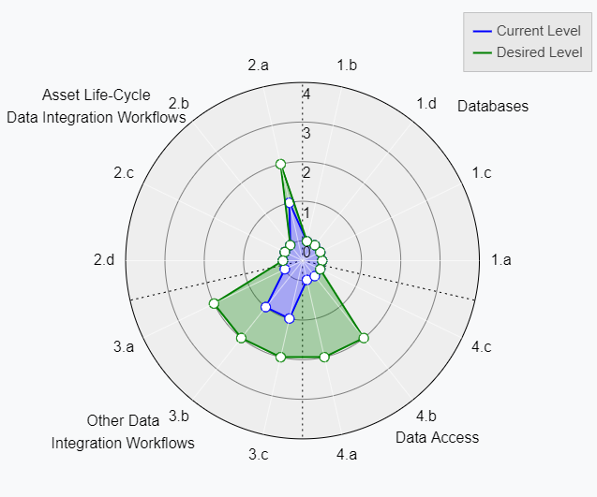
Area C: Store, Integrate, and Access Data
Area Description:
Manage data efficiently and integrate across asset lifecycle phases, processes, and systems
General Assessment Summary:
<insert 1-3 key themes>
General Improvement Recommendations:
<insert 0-3 key improvements
Placeholder
Replace with Radar Chart from TAM Data Assistant

Slide 12
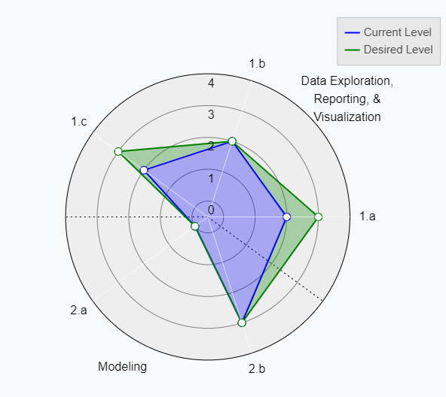
Area D: Analyze Data
Area Description:
Advance tools and practices for transforming raw data into information that can support TAM decision-making
General Assessment Summary:
<insert 1-3 key themes>
General Improvement Recommendations:
<insert 0-3 key improvements
Placeholder
Replace with Radar Chart from TAM Data Assistant

Slide 13
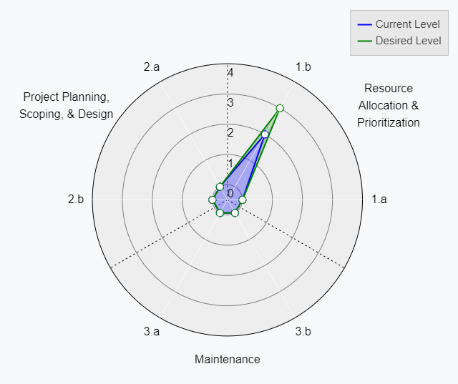
Area E: Act on Data
Area Description:
Better incorporate data and information within TAM processes
General Assessment Summary:
<insert 1-3 key themes>
General Improvement Recommendations:
<insert 0-3 key improvements
Placeholder
Replace with Radar Chart from TAM Data Assistant

Slide 14
Detailed Action Plan

Slide 15
Proposed Improvement Actions
<Insert General Improvement Grouping 1>
<Insert General Improvement Grouping 2>
<Insert General Improvement Grouping 3>
1
<Insert proposed improvement name>
2
<Insert proposed improvement name>
3
<Insert proposed improvement name>
4
<Insert proposed improvement name>
5
<Insert proposed improvement name>
6
<Insert proposed improvement name>
7
<Insert proposed improvement name>

Slide 16
Action Plan Concepts
Implementation Lead
Identifies who should lead the action
Note: may be specific groups or individuals
Benefit of Taking Action
How the action will address an identified gap or achieve an identified business need
Status
Proposed = envisioned, but not yet committed to execution
Planned = committed to execution, but not yet underway
In Progress = underway and not yet complete
Complete = the activity has been completed
Priority
Relative priority for action (Low / Medium / High):
What is most important to do first (or now)?
Low hanging fruit or impact vs. effort?
What can be accomplished with existing resources?
Dependencies with other actions
Difficulty
Relative level of effort (Low / Medium / High):
Technical complexity of the action
Required expertise or organizational capabilities
Change management implications
Impact to existing processes and stakeholders

Slide 17
Improvement #
<Insert Proposed Improvement Name>
<insert general improvement grouping 1>
Description:
<insert description>
Support:
<insert supporting concepts or considerations>
<insert supporting concepts or considerations>
<insert supporting concepts or considerations>
Implementation Lead
TBD
Benefit of Taking Action
TBD
Status
TBD
Priority
TBD
Difficulty
TBD

Slide 18
Improvement #
<Insert Proposed Improvement Name>
<insert proposed improvement grouping 2>
Description:
<insert description>
Support:
<insert supporting concepts or considerations>
<insert supporting concepts or considerations>
<insert supporting concepts or considerations>
Implementation Lead
TBD
Benefit of Taking Action
TBD
Status
TBD
Priority
TBD
Difficulty
TBD

Slide 19
Improvement #
<Insert Proposed Improvement Name>
<insert proposed improvement grouping 3>
Description:
<insert description>
Support:
<insert supporting concepts or considerations>
<insert supporting concepts or considerations>
<insert supporting concepts or considerations>
Implementation Lead
TBD
Benefit of Taking Action
TBD
Status
TBD
Priority
TBD
Difficulty
TBD

Slide 20
Next Steps
<Insert Next Step>
<Insert Next Step>
<Insert Next Step>

Slide 21
Thank you
Contact information
  For more info, please contact:
  <insert contact name >
  <insert contact email>
  <insert contact name >
  <insert contact email>

