Slide 1
An Example Application of the
Framework for TAM Data and Information System Investments
Entirely Hypothetical!!!
Notes:
If you have questions reach out to Will Duke (at Spy Pond Partners) who helped develop this as part of the NCHRP 08-115 Research Implementation activities.

Slide 2
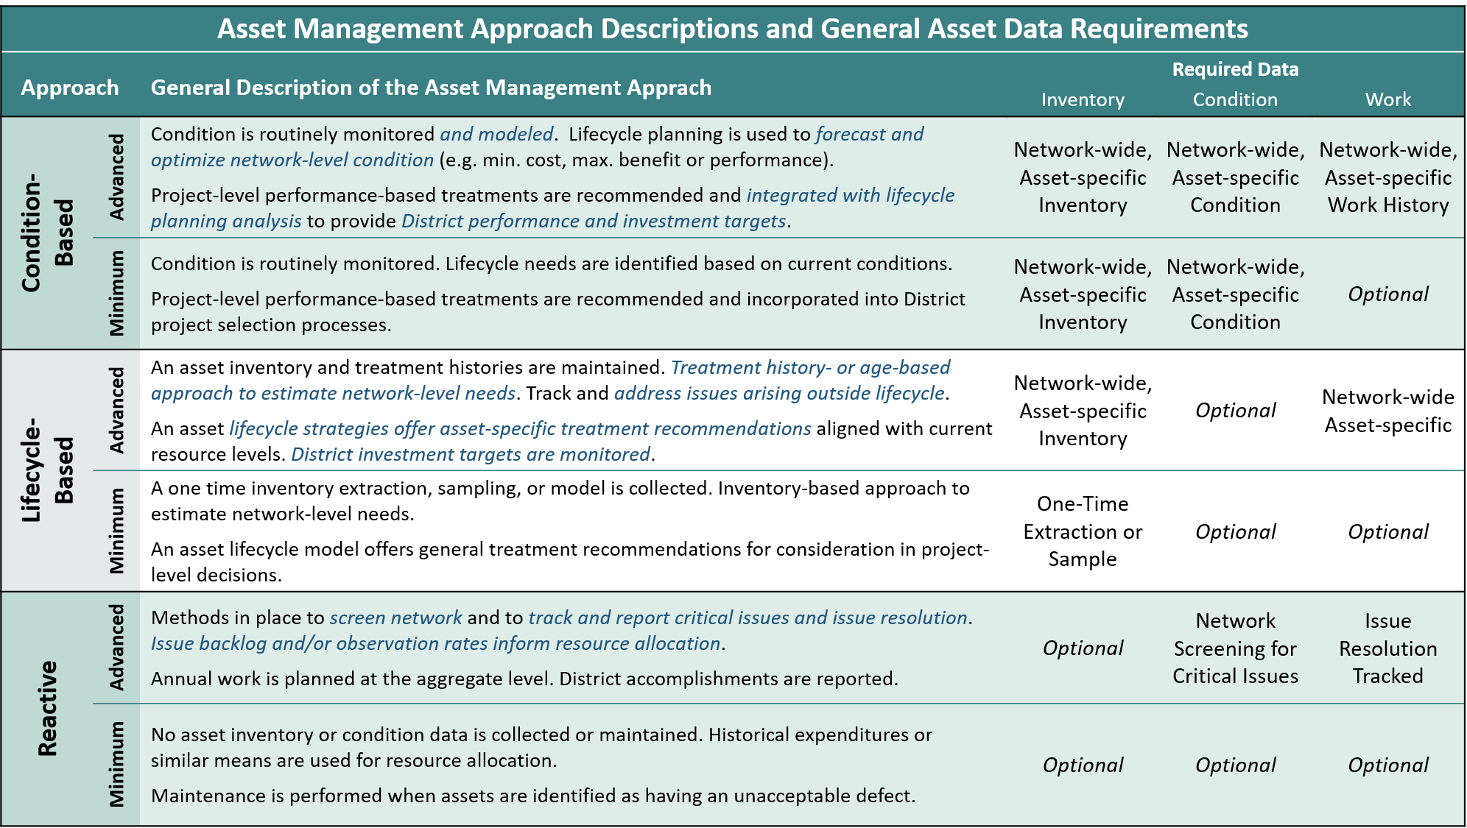
Approach Definition and Data Requirements Evaluation
Selecting an Approach
Entirely Hypothetical!!!
An application example for
Guardrail
Selected Approach:
Limited asset data collection – GR investments will be driven by non-lifecycle needs.
Identification, tracking and resolution of safety issues
Option for a simple inventory (i.e. track end terminal products and locations)
Reactive
(Advanced)
Notes:
Three general management approaches are defined - a reactive approach, a lifecycle based approach, and a condition based approach
Each of these are further subdivided into a minimum and advanced level of application. At the minimum level, you won't have all the bells and whistles, but you should still be able to execute at a reasonable level (for the approach). At the advanced level, you will be focused on extending the capabilities that are most meaningful to that approach.
As you can see a detailed definition, as well as some very high-level data requirements, are presented to help make an initial decision. From there, the framework gets much more detailed, allowing for a robust exploration of supporting data models and system capabilities that are aligned with the approach you select.

Slide 3
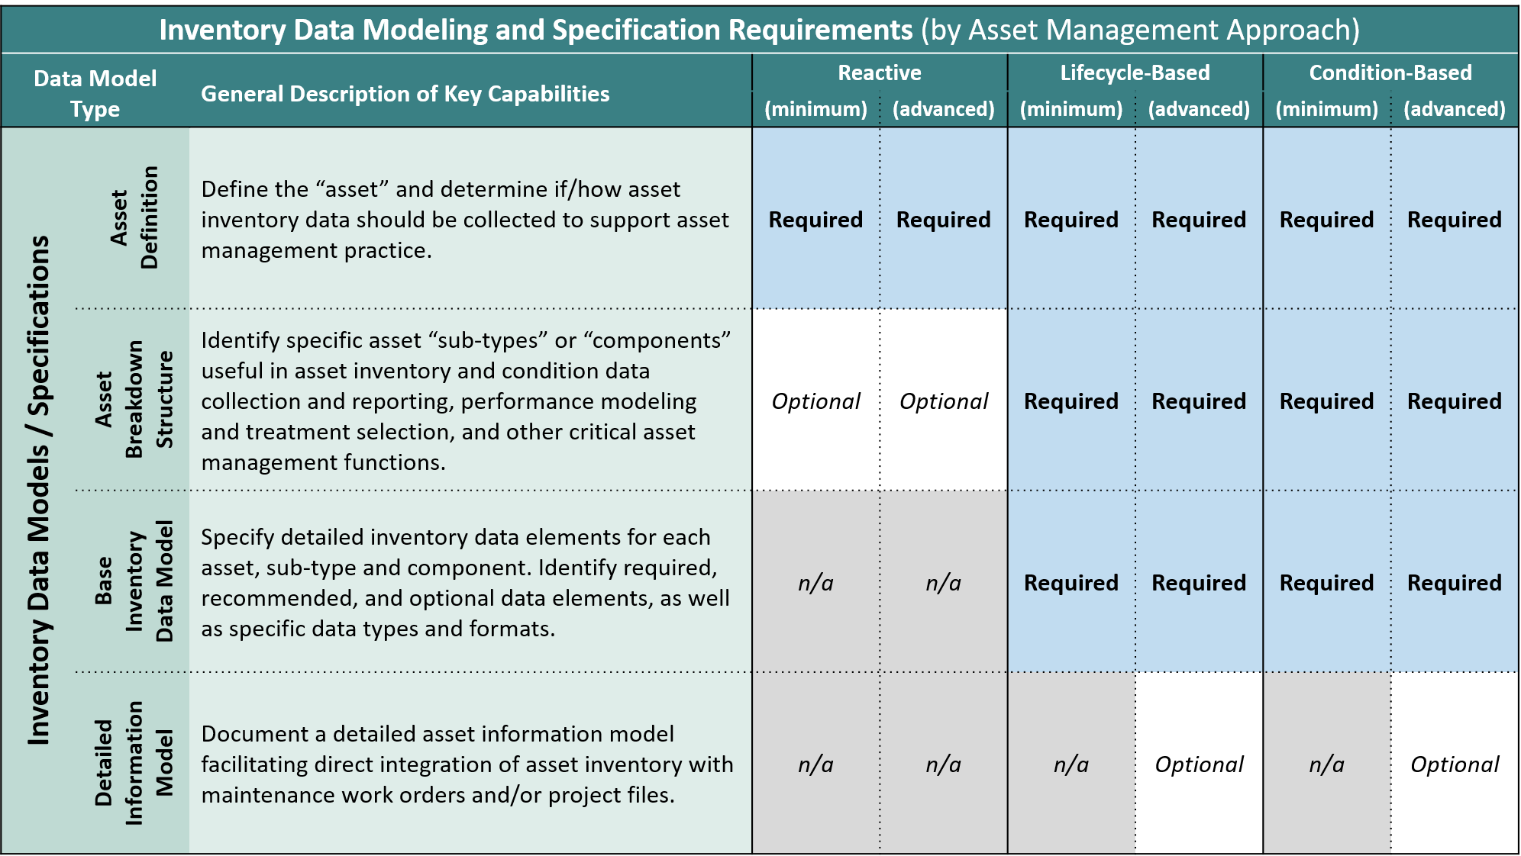
Approach Definition and Data Requirements Evaluation
Evaluating the Inventory Data Model
Entirely Hypothetical!!!
An application example for
Guardrail
Define the asset.
Traffic barrier systems installed to contain and redirect vehicles from departing the road, not including concrete barrier systems.
Should inventory data be collected?
Optional: High-level run-on end terminal type, product and location should be maintained
Identify asset types / components.
W-beam / cable guardrail
Run-on and run-off terminals, rail
Any key data elements?
Run on terminal type and product
Terminal GPS location
Address Required and Optional items for the selected approach

Slide 4
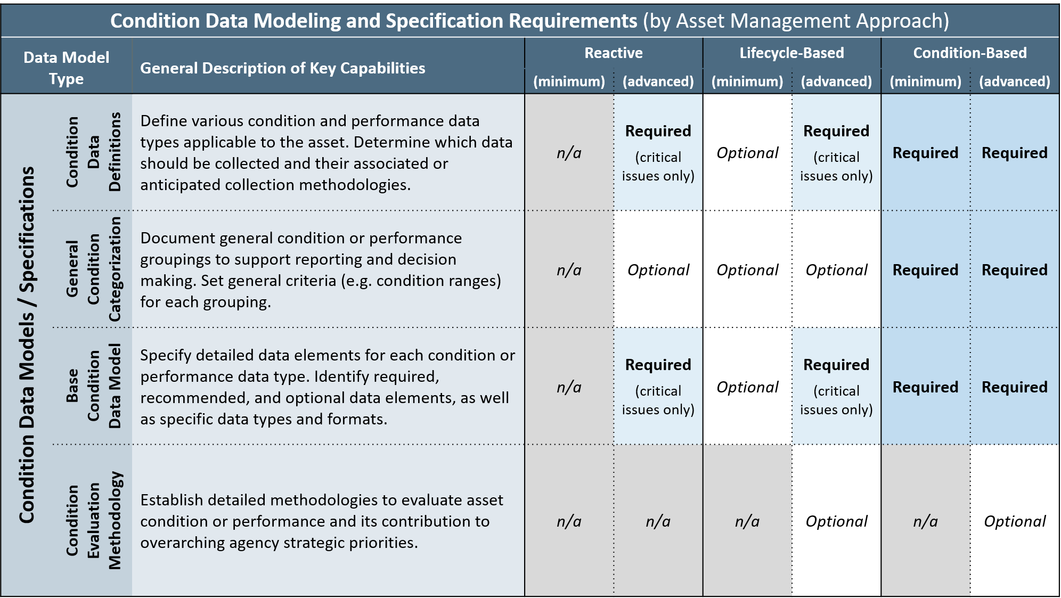
Approach Definition and Data Requirements Evaluation
Evaluating the Condition Data Model
Entirely Hypothetical!!!
An application example for
Guardrail
Define condition data types.
Windshield screening assessment
Issue report
Detailed field inspection
Should condition data be collected?
Windshield screening – recurring
Reported issues – when reported
Inspections – by project
Identify condition types.
Obsolete – no longer acceptable
Severe Condition Issue – e.g. damage, steel blockouts, concrete post, major rust/rot, low height
Any key data elements?
Observation GPS, Side of Road
Issue Type (LOV)
Address Required and Optional items for the selected approach

Slide 5
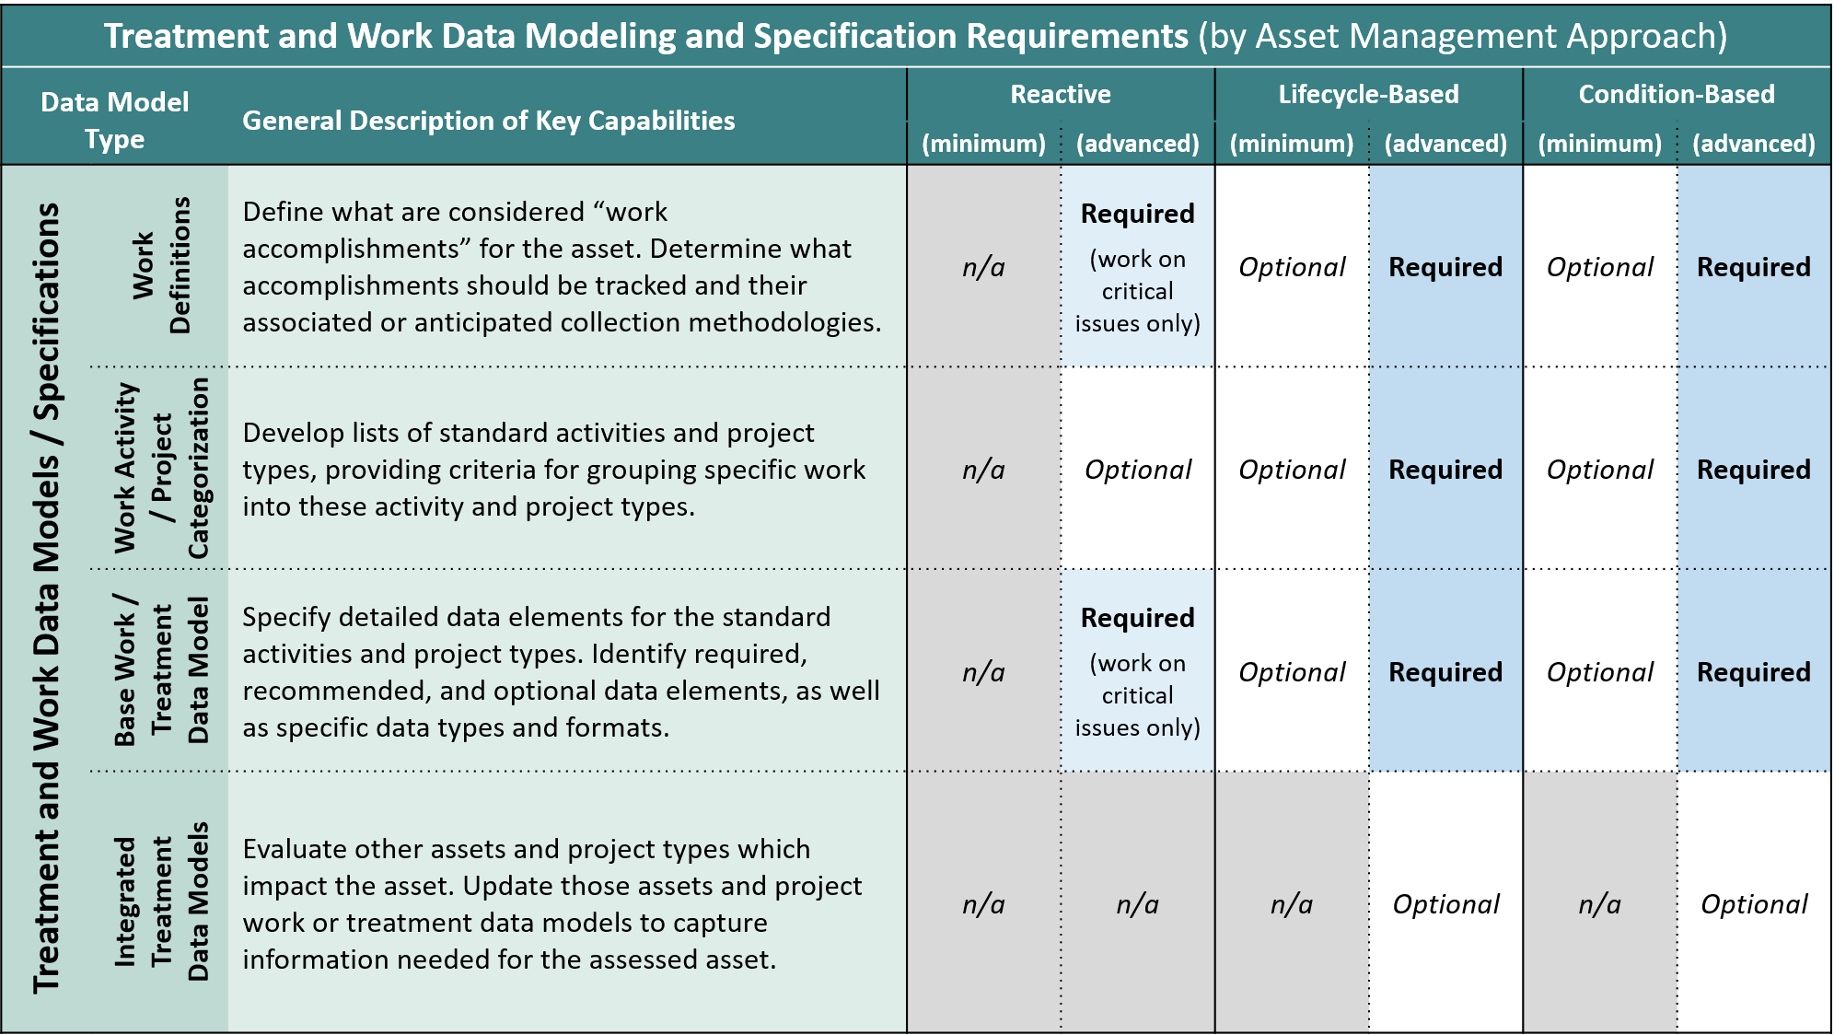
Approach Definition and Data Requirements Evaluation
Evaluating the Work Data Model
Entirely Hypothetical!!!
An application example for
Guardrail
Define work accomplishments.
Full replacement of any component
Any spot repair >100’
Should work data be collected?
Work Orders completed against priority issues / observations
Option: Track aggregated quantities of other work
How is work data captured?
Priority issue resolution – AMS work order completion
Quantities – planned projects
Any key data elements?
Related Observation
Work Order Completion Date
Address Required and Optional items for the selected approach

Slide 6
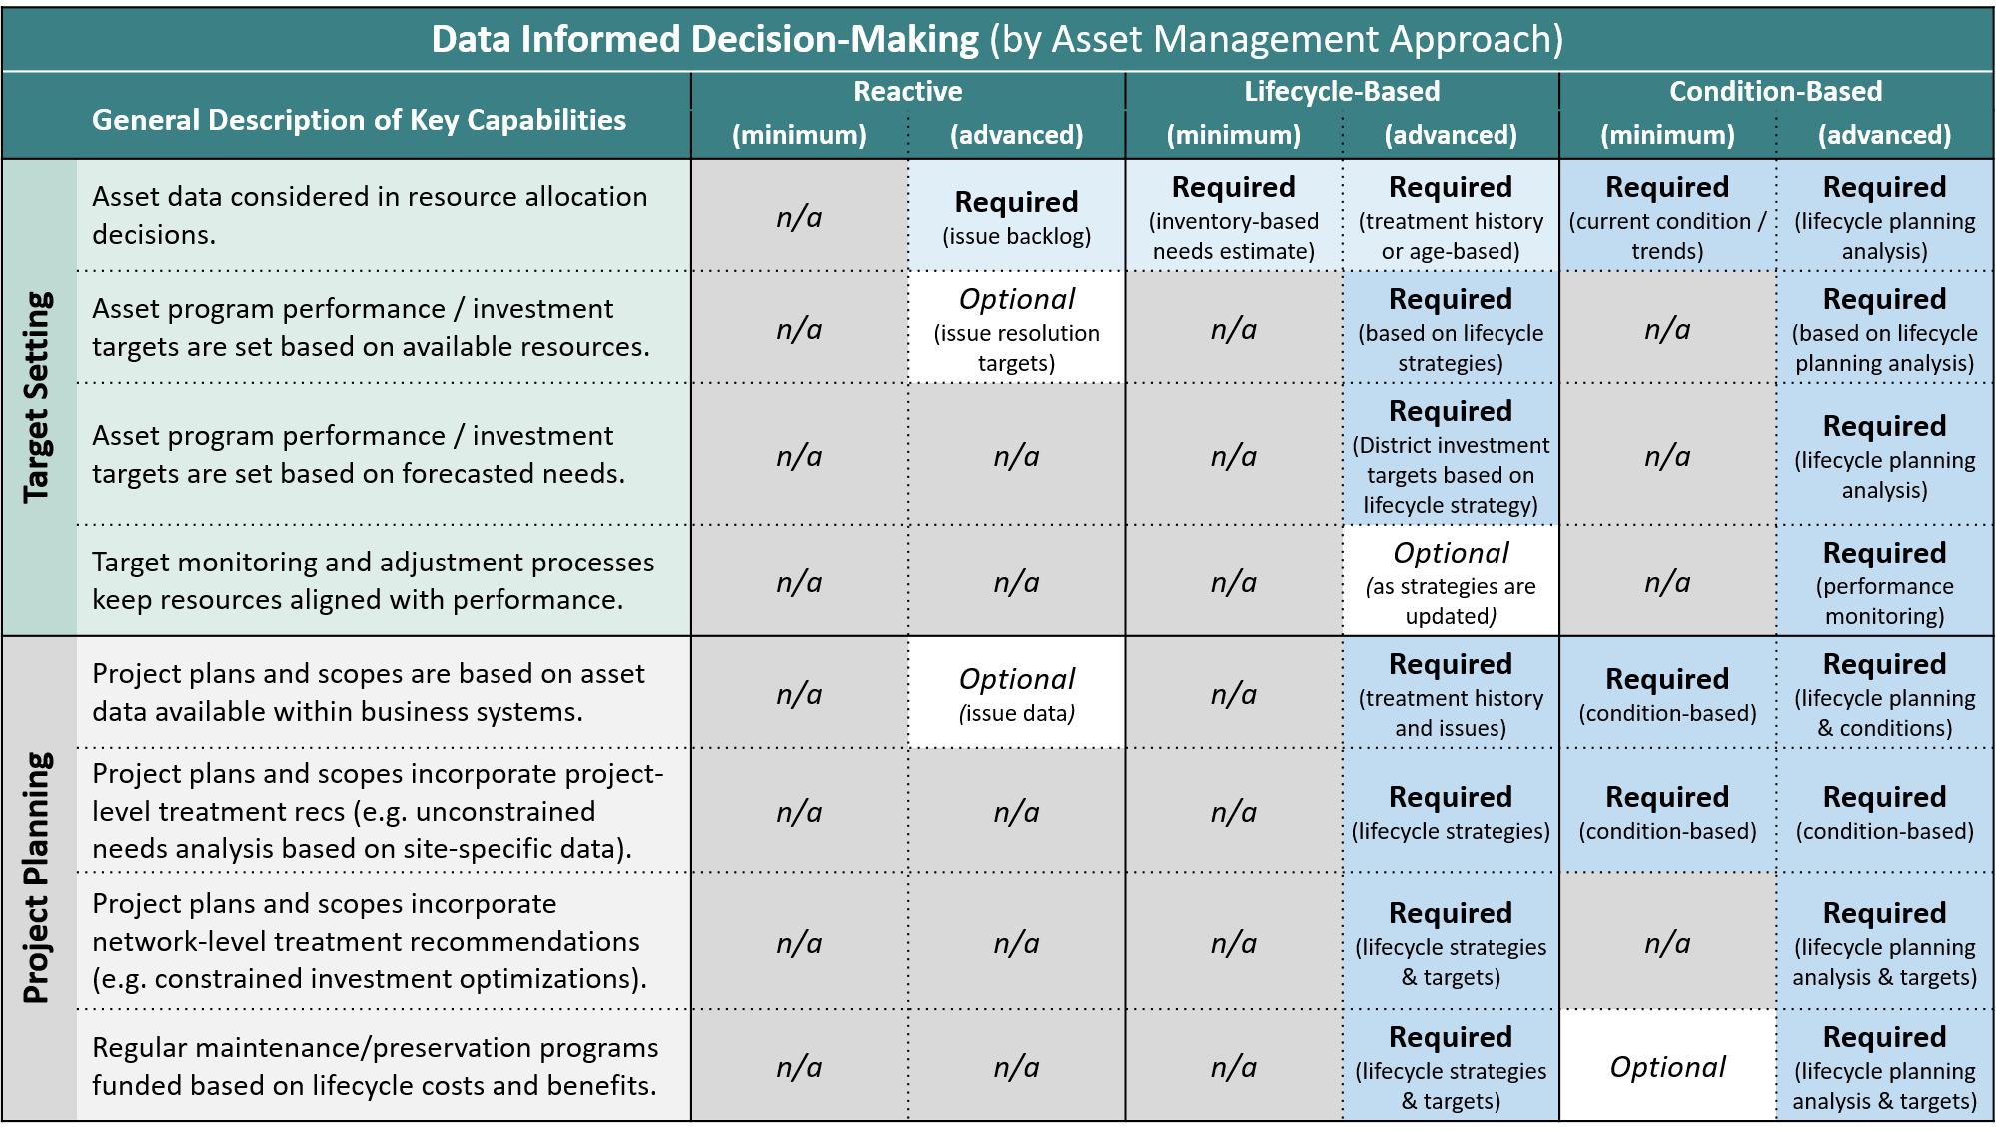
Data and Information System Capabilities Evaluation
Decision-Making Capabilities
Entirely Hypothetical!!!
An application example for
Guardrail
Resource Allocation Method
Set annual budget based on issue backlog and previous investments
Investment Targets
Option: Set targets for number of priority issues address with funds
Forecasting / Monitoring
No capabilities necessary for selected management approach
Project Planning
Option: Pre-populate work orders in the AMS / MMS / WMS based on priority issues
Treatment Recommendations
No capabilities necessary for selected management approach
Address Required and Optional items for the selected approach

Slide 7
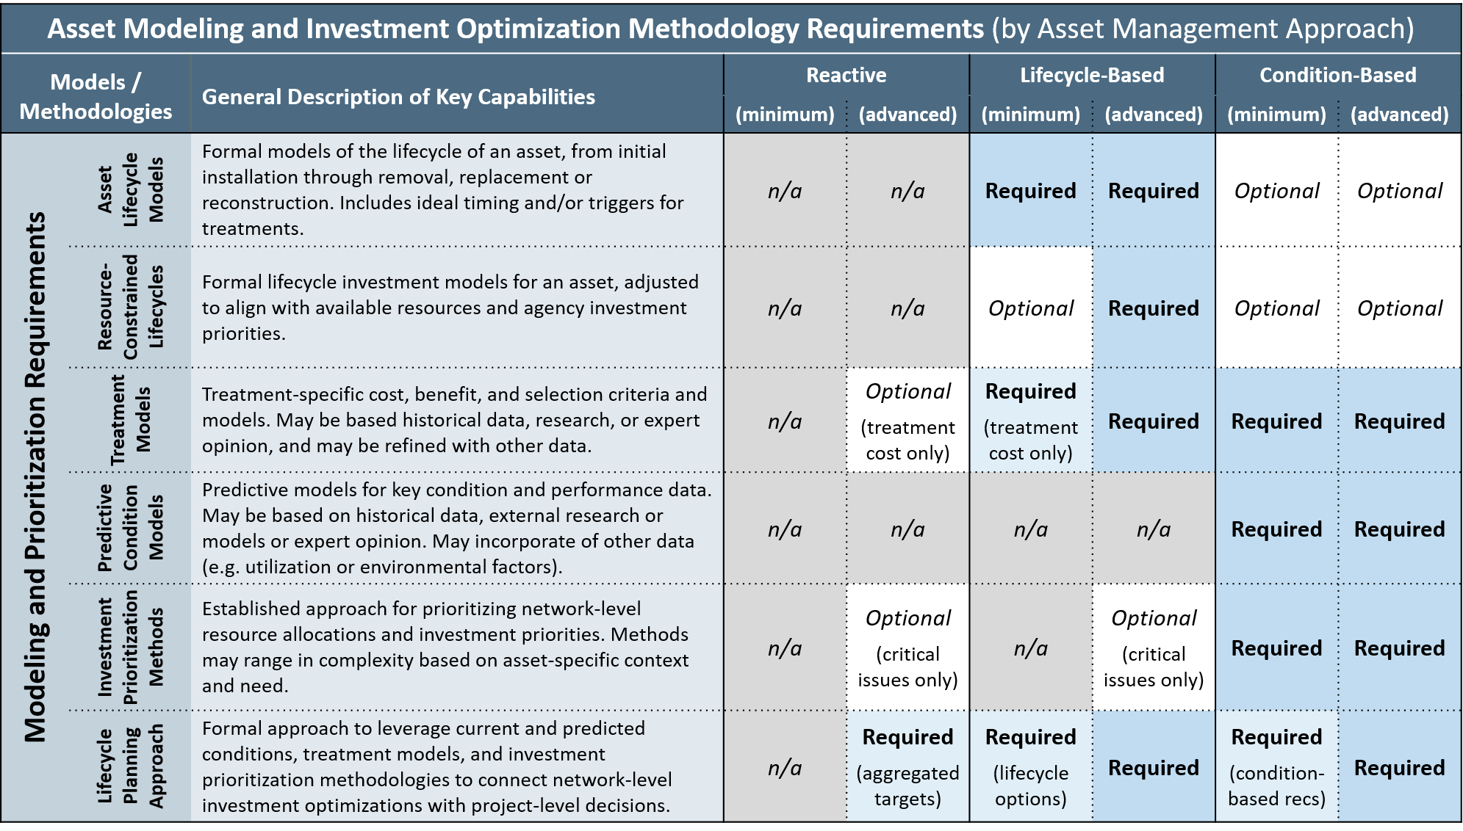
Data and Information System Capabilities Evaluation
Modeling and Prioritization
Entirely Hypothetical!!!
An application example for
Guardrail
Asset Lifecycle Modeling
No capabilities necessary for selected management approach
Treatment Modeling
Option: model typical activities – use bid tabs or state force material, equipment, labor costs
Predictive Condition Models
No capabilities necessary for selected management approach
Investment Targets
Option: Prioritize known issues – severity, traffic, accident data
Lifecycle Planning Approach
District and system-specific targets– based on allocations
Address Required and Optional items for the selected approach

Slide 8
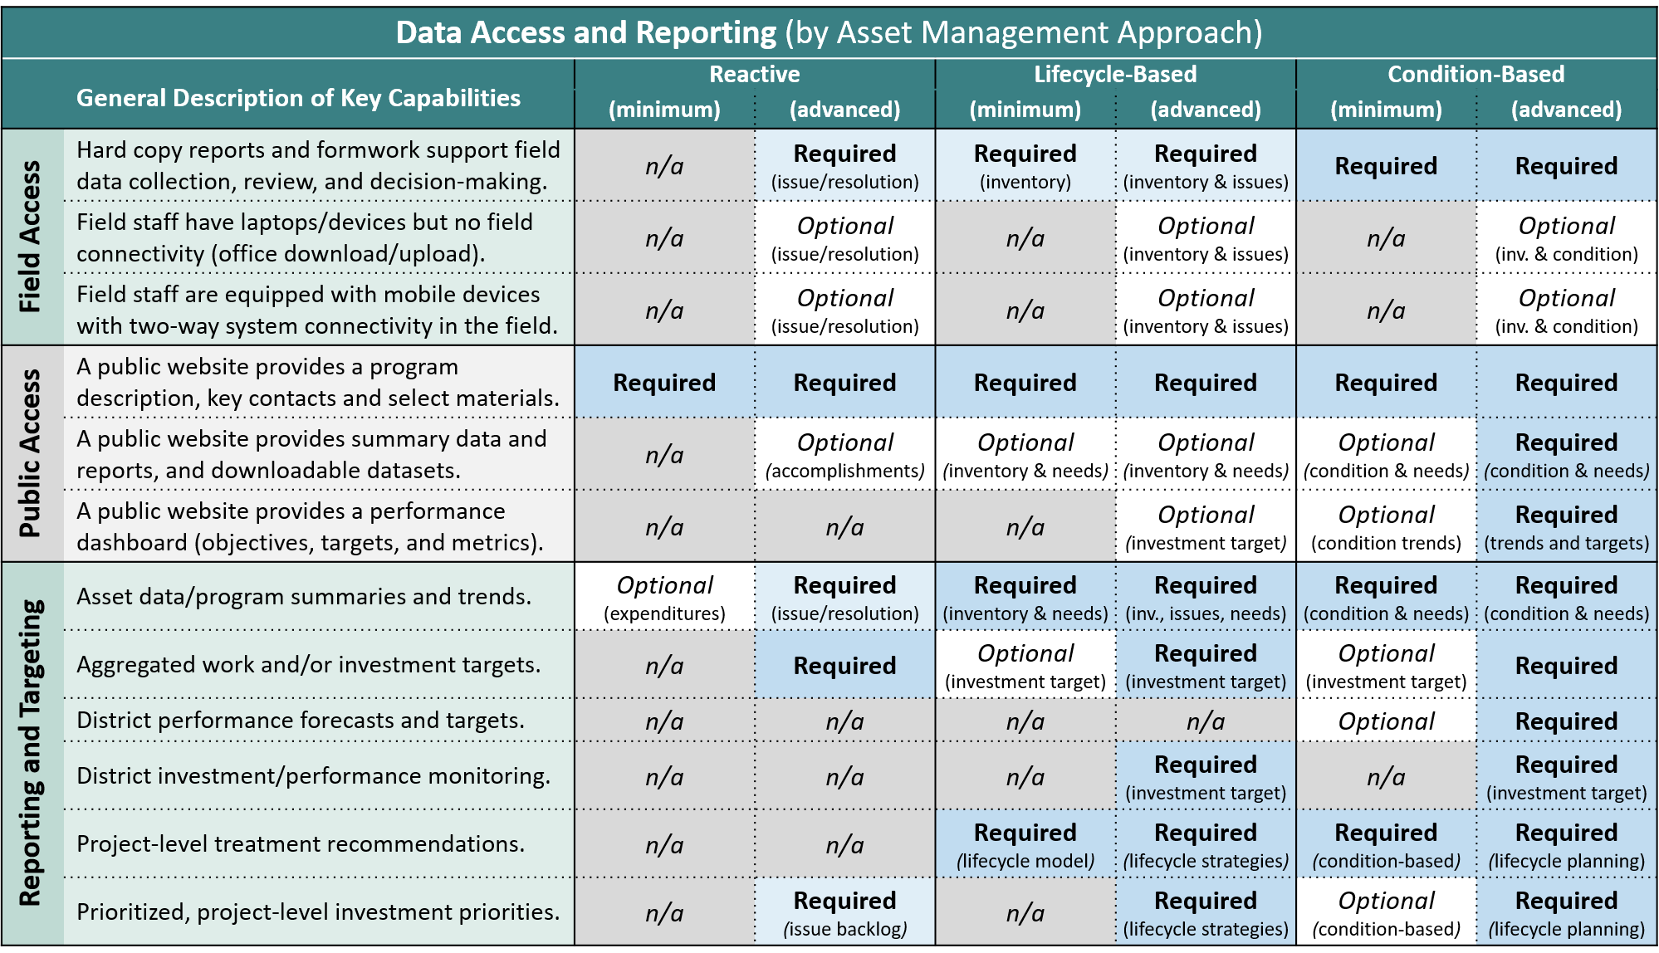
Data and Information System Capabilities Evaluation
Data Access and Reporting
Entirely Hypothetical!!!
An application example for
Guardrail
Field Access
Windshield data collection form (supporting 2-person, vehicle based issue tracking)
Mobile tools to capture and review issues
Mobile tools to create, update and complete work orders
Public Access
Website with GR program description and contacts
Option: include summary data regarding past accomplishments
Reporting and Targeting
District- and system-specific reporting of issue backlog, work accomplishments and trends
Option: priority issue lists
Address Required and Optional items for the selected approach

Slide 9
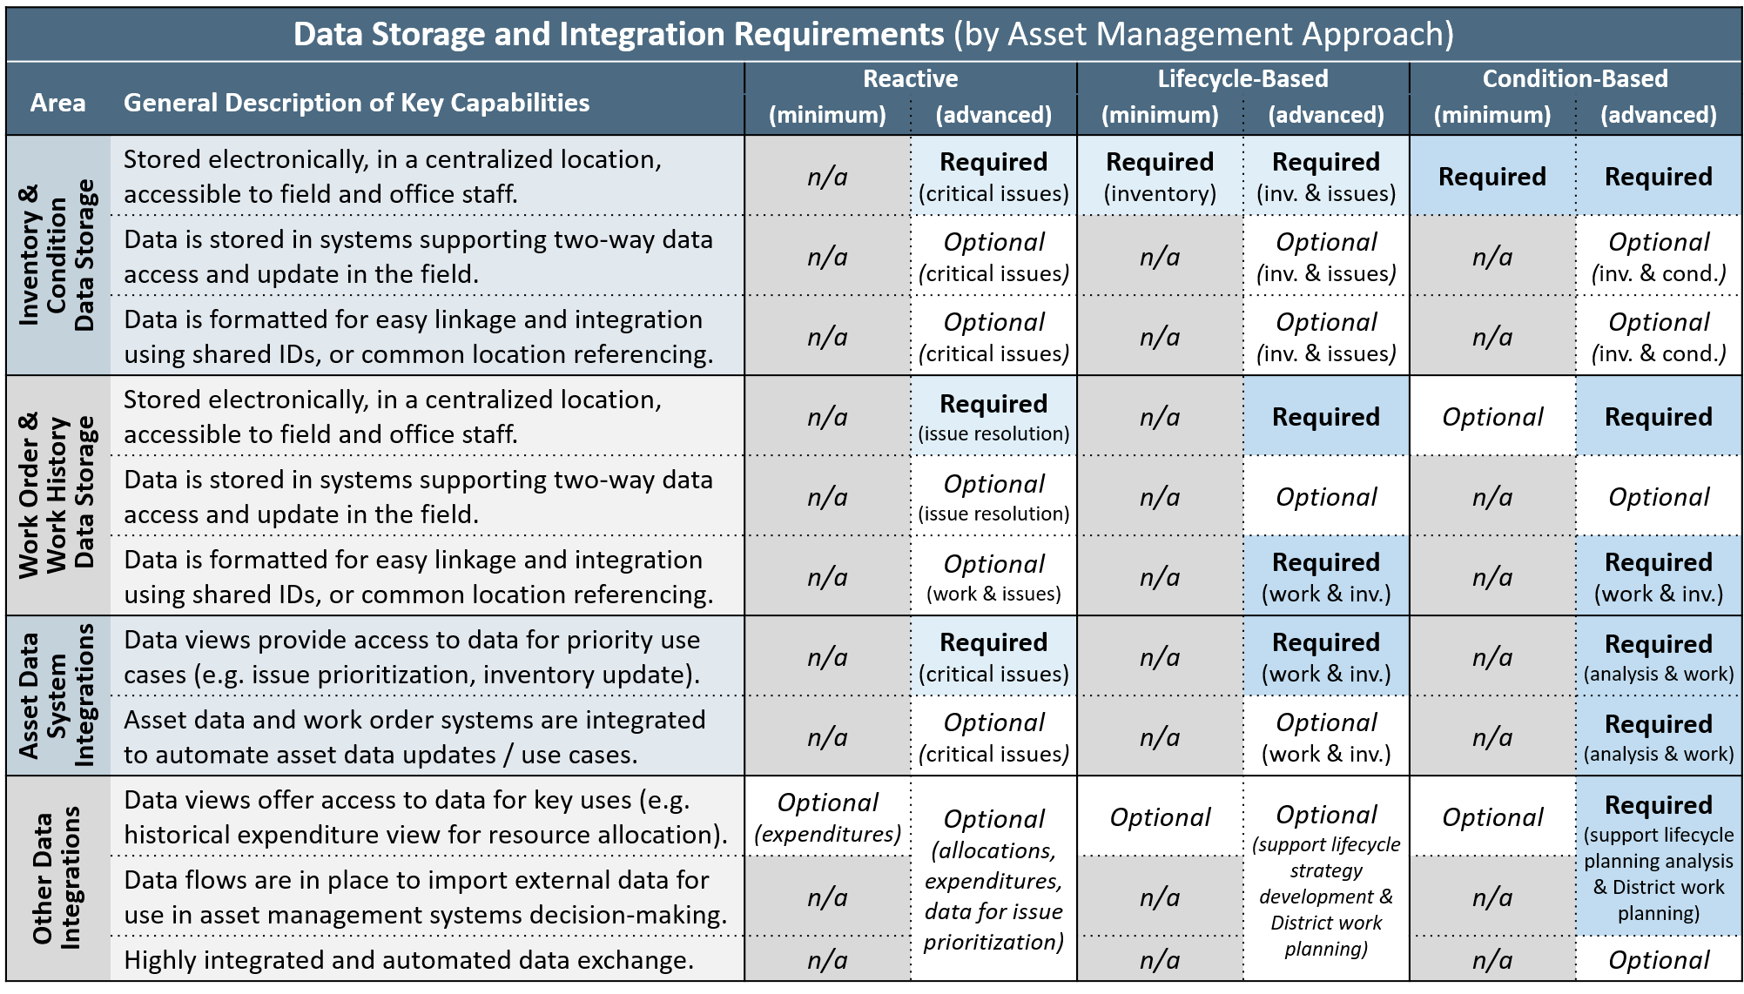
Data and Information System Capabilities Evaluation
Data Storage and Integration
Entirely Hypothetical!!!
An application example for
Guardrail
Inventory & Condition Data Storage
Centralized, map-based, field accessible repository for GR issues (e.g. ArcGIS Online app)
Post process LRS to provide route and milepoint information
Work Order & History Data Storage
Track issue resolution (tool above)
Calculate and store aggregated GR work in a central repository
Asset Data System Integration
Integrate GR issues / work orders
Other Data Integration
Option: Import traffic, crash history to support prioritization
Option: Import CRM requests for issue creation / prioritization
Address Required and Optional items for the selected approach

Slide 10
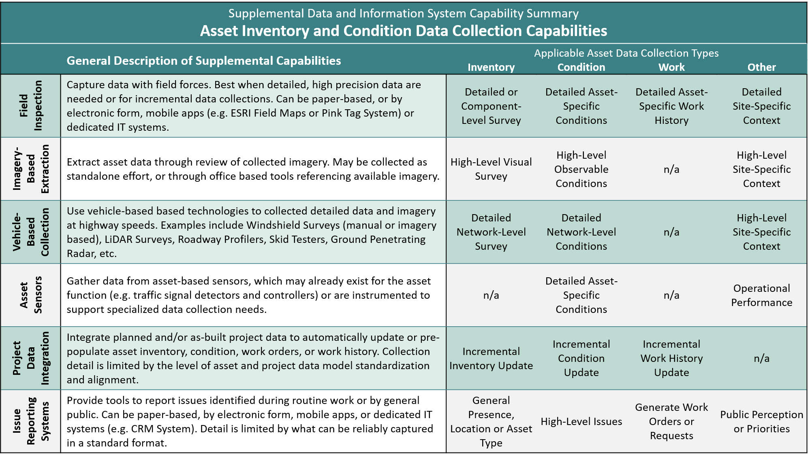
Data and Information System Capabilities Evaluation
Inventory & Condition Data Collection
Entirely Hypothetical!!!
An application example for
Guardrail
Field Inspection
Issue / basic inventory mobile app
Option: detailed GR inspection form (for project-specific data)
Imagery-Based Extraction
Virtual GR windshield assessment tool – use with pavement imagery
Vehicle-Based Collection
Paper-based GR windshield assessment form (w/ upload tool)
Asset Sensors
No capabilities necessary
Project Data Integration
No capabilities necessary
Issue Reporting System
Option: CRM – GR request form
Identify Collection Methods for Required Inv. and Condition Data

Slide 11
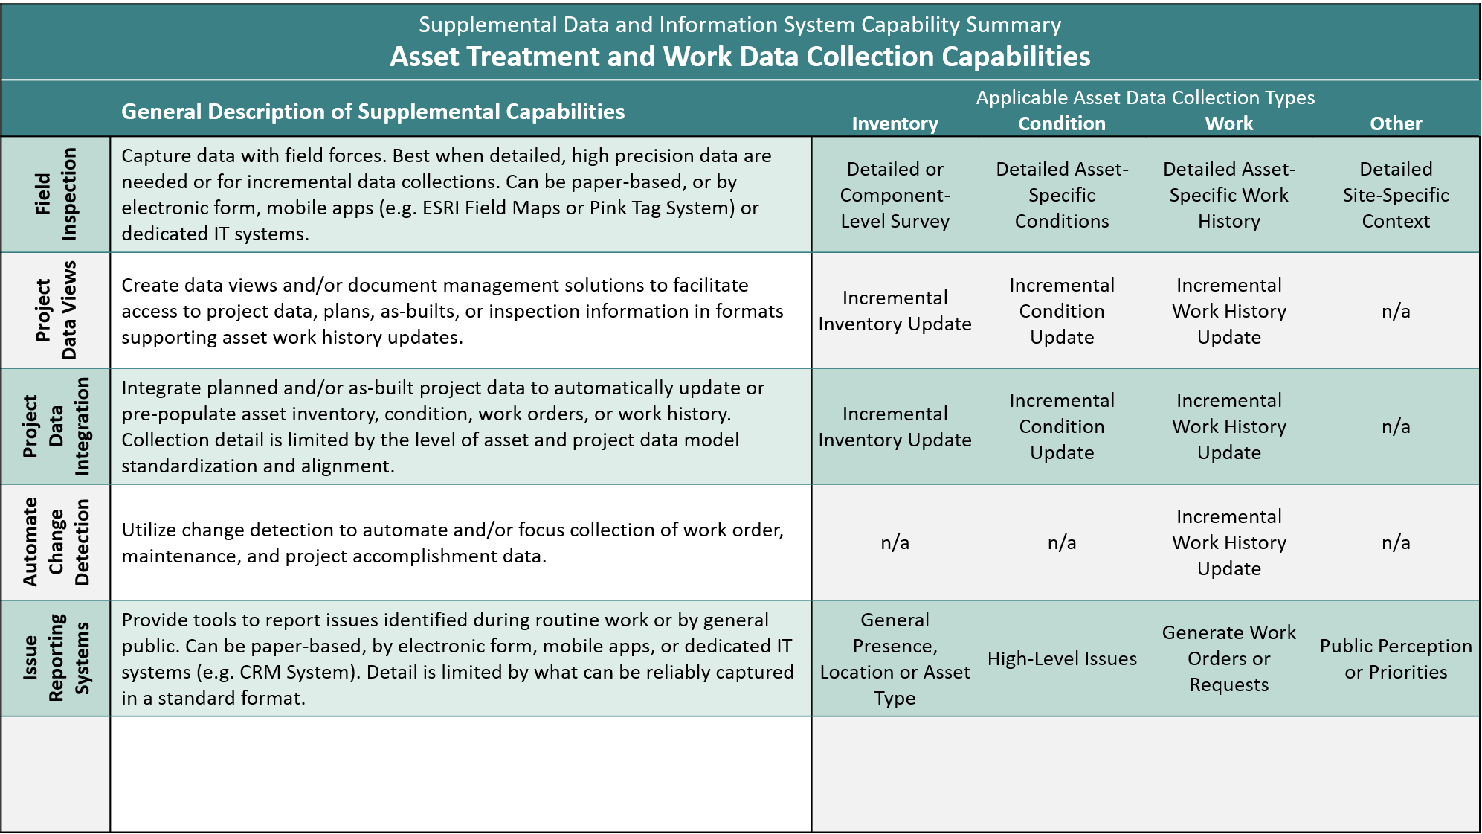
Data and Information System Capabilities Evaluation
Treatment and Work Data Collection
Entirely Hypothetical!!!
An application example for
Guardrail
Field Inspection
Issue resolution mobile app
Project Data Views / Integration
Option: map-based overlay and/or integration of GR project locations & known issue locations – to support issue resolution
Automated Change Detection
No capabilities necessary
Issue Reporting System
Option: CRM – GR request form
Identify Collection Methods for Required Work Data

