Slide 1
Strategic Framework for: TAM Data and Information System Investments

Slide 2
Motivation for the Framework
Become more strategic when investing in…
TAM Data,
Systems, and
Processes.
Many DOT TAM programs are working to prioritize and tier their assets.
A systematic approach is needed to align:
New and ongoing data collection
Enhancements to systems and tools
Limited data management resources
Investments across program silos
Be confident your asset data and system capabilities
meet your intended management approaches.
Notes:
DOTs are looking to become more strategic in how they invest in TAM data, systems, and processes. This is aligned with your work to prioritize and tier your assets, and calls for a systematic approach. At the end of the day, asset management is all about making the right investments at the right time - investments in TAM data and systems should be no different.

Slide 3
The Solution
Connect two methodologies
MN DOT Framework
Asset Management Approach Concepts
Matrixed Checklist Organization
AASHTO TAM Data Guide
Detailed Practice and Capability Benchmarks for TAM Data and Information Systems
3
Notes:
The framework Minnesota DOT created to evaluate their asset management approaches and associated data needs and the AASHTO TAM Data Guide were connected to create a more detailed framework that helps evaluate potential asset management approaches with required data and information system capabilities

Slide 4
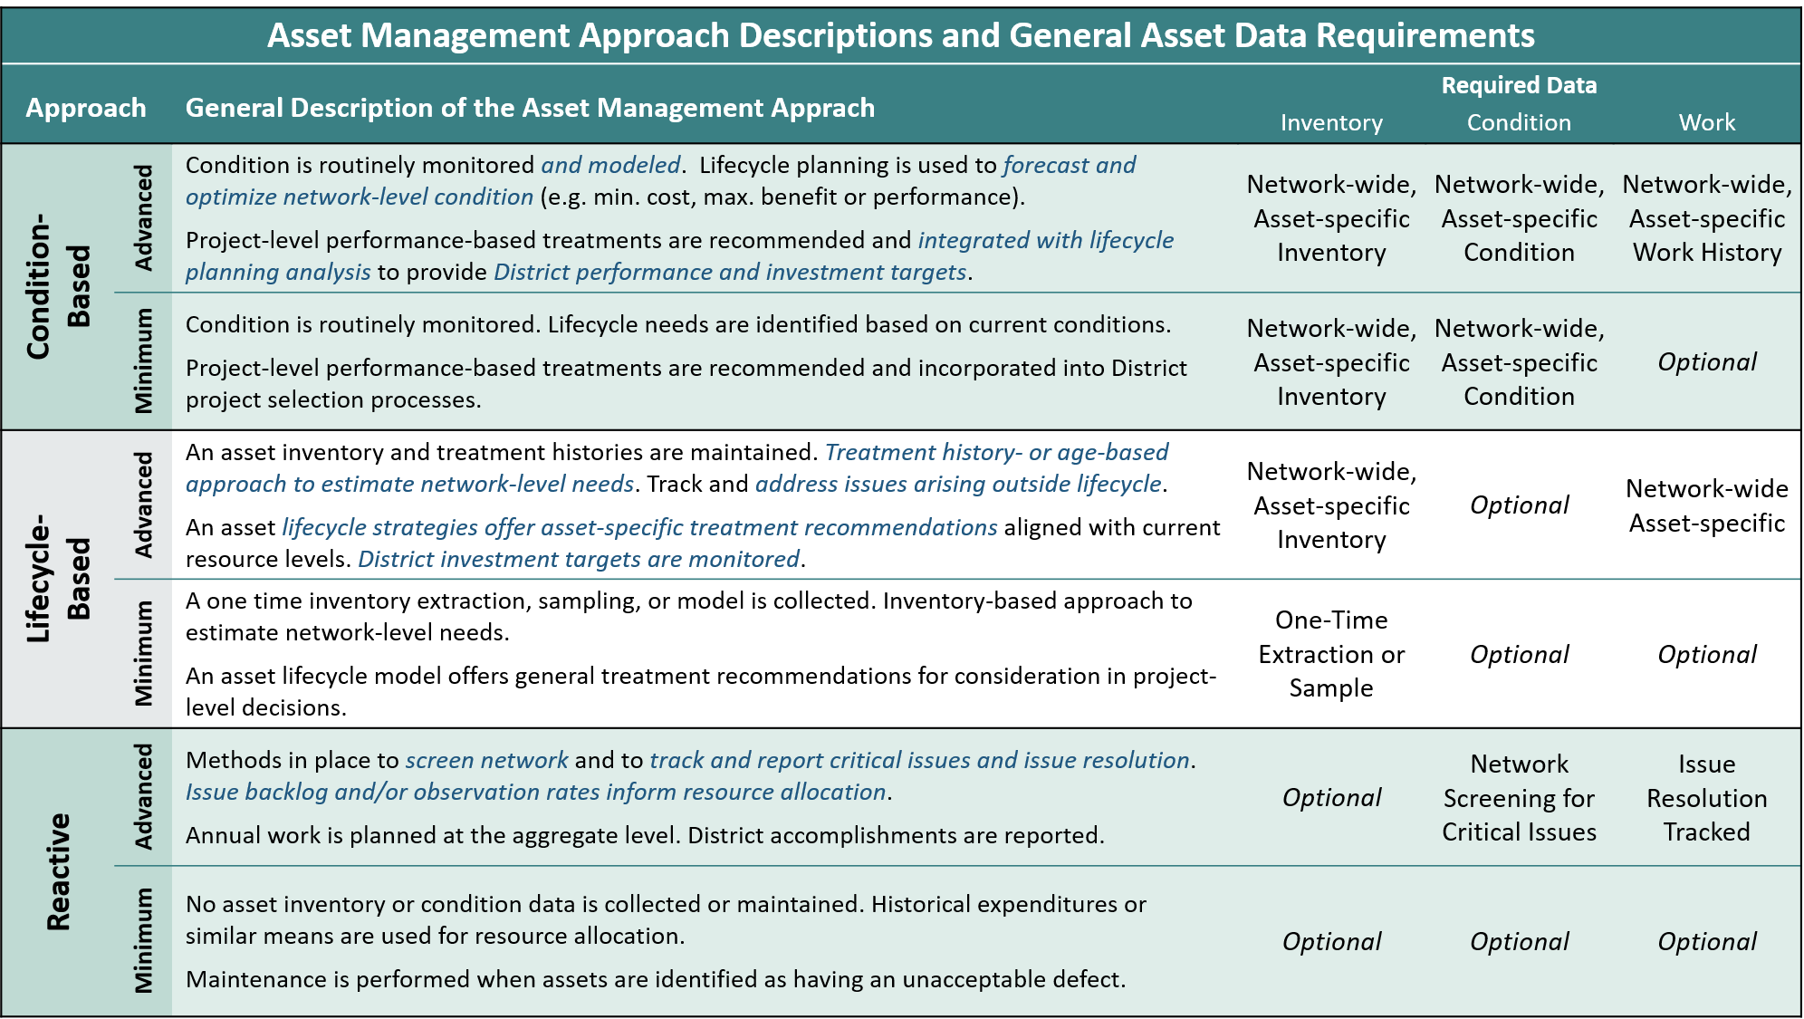
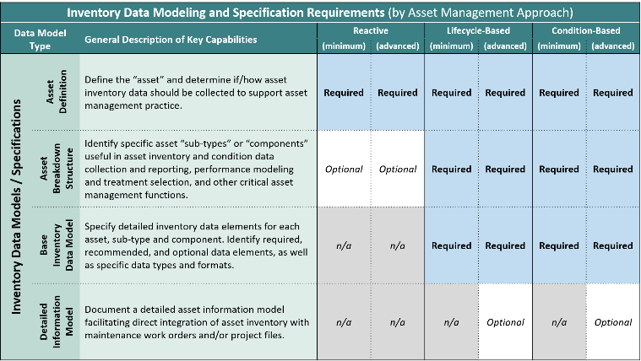
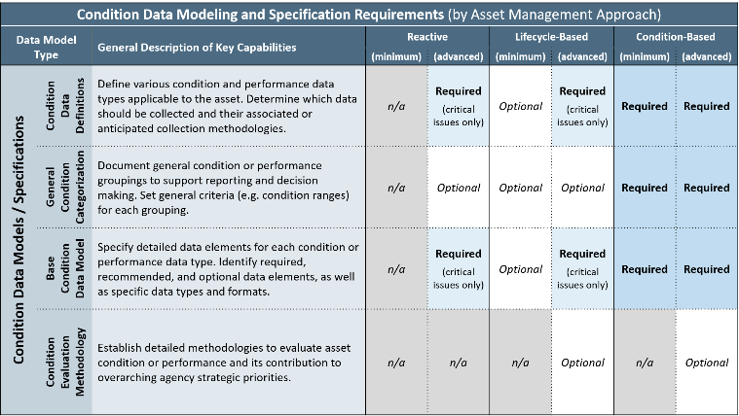
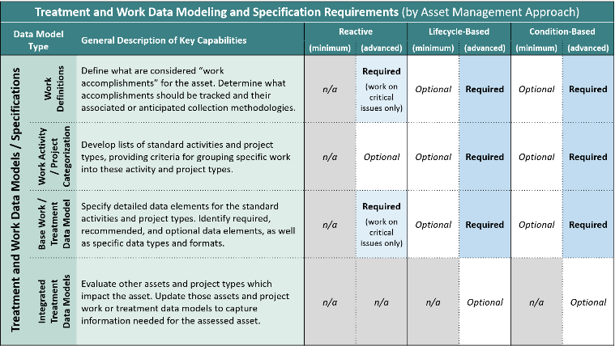
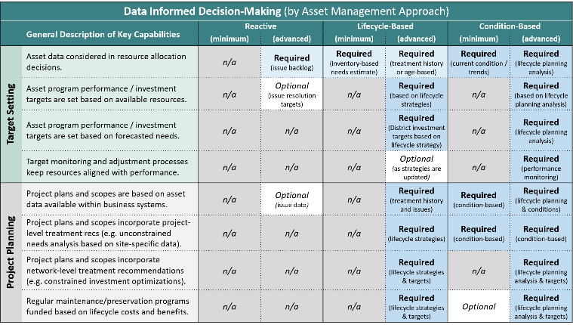
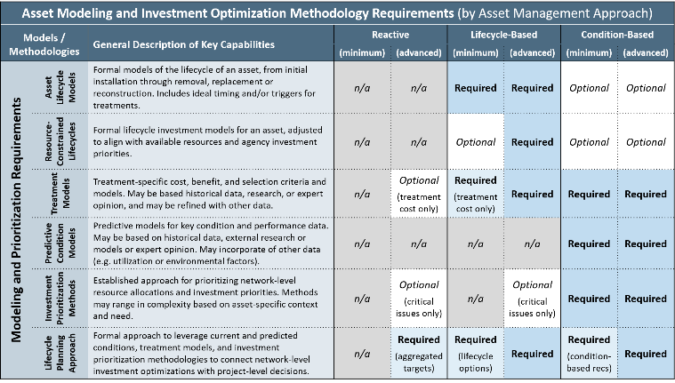
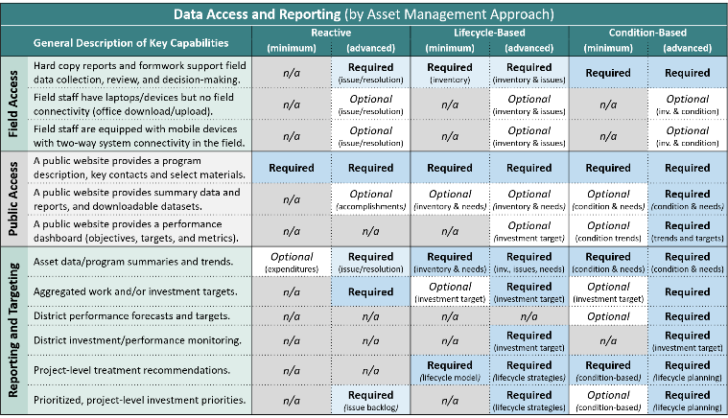
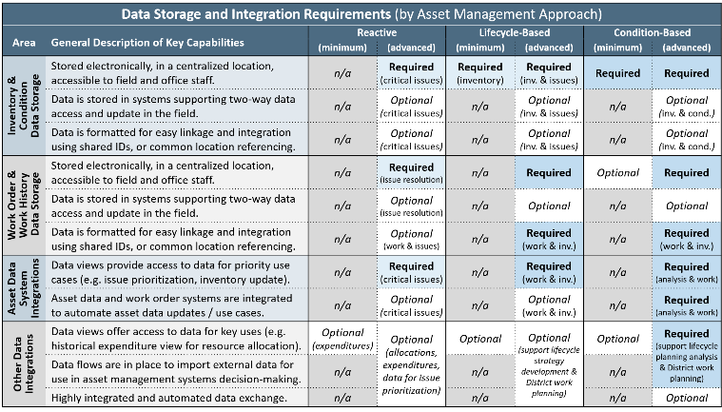
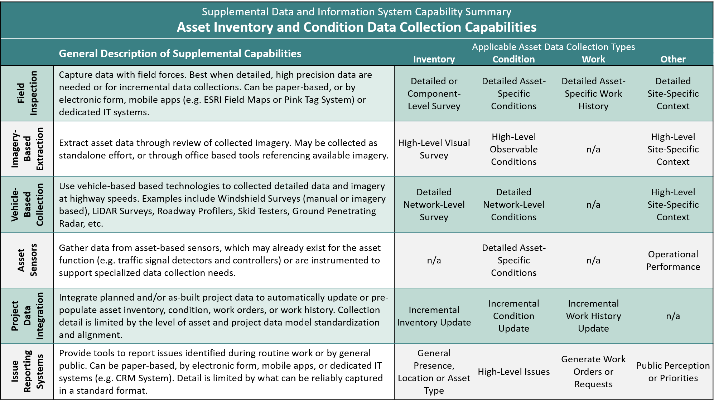
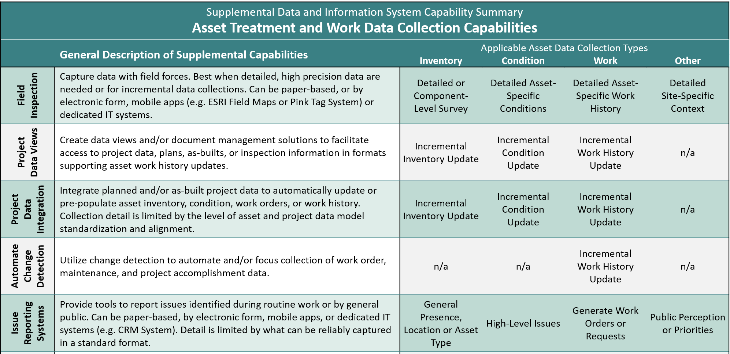
The Strategic Framework for TAM Data and Information System Investments
Approach
Data Models
Support Capabilities
Data Collection
A Series of Matrices
Organized by tiered management approaches.
Linked to potential data and information system capabilities.
Providing a structured approach to identify:
What management approach is intended for your asset?
What data is required, optional, or not needed for the approach?
What data informed decisions are intended to be supported?
What analytical methodologies should be in place?
What data access and reporting capabilities are expected?
How should data be stored and integrated?
What data collection methodologies may be appropriate?
Notes:
The framework consists of a series of matrices.
Each matrix presents a different data type (e.g. inventory data or work data) or general area of information system capabilities (e.g. Data Access or Report).
Walking through each matrix allows the user to ask and answer critical questions about specific required or optional capabilities - it also highlights were certain data or capabilities may not be necessary for a given management approach
At the end of the process, the user should have a good idea of what is necessary to execute on their envisioned management approach

Slide 5
Applying the Framework
Pre-Requisite Activities
Step 1: Identify the Targeted Asset
Step 2: Gather Stakeholders and Decision-Makers
TAM Program Leadership
Data Stewards / Systems Owners
Asset-Specific SMEs
Field Representatives
District Management
Executive Management
Step 3: General Framework Review and Discussion
Be sure everyone understands what is being decided!
Framework Application
Step 4: Select Desired Management Approach
Be sustainable – consider resources, current data and tools, culture, asset priority, etc.
Step 5 & 6: Evaluate Data and Capabilities
Address all required / optional elements for the selected approach
Assessment Outcomes
Step 7: Gap Analysis
Compare current vs. desired data / capabilities
Document gaps and identify opportunities
Recommend actions to streamline current state and expand into desired capabilities
Notes:
Applying the framework is a relatively straightforward process:
As is typical of most self-assessment methodologies - the value is in the discussion - so it is important that you gather a small group of informed stakeholders to participate in the process
Each asset program should be evaluated separately, and it is critical to identify the desired management approach early in the process - that is necessary to inform detailed data and capabilities evaluation
At the end of the process, you can perform a gap analysis on the asset data and system capabilities - however findings across multiple asset programs could be reviewed against each other to identify further synergies (e.g. in data collections, or supporting systems and tools)

Slide 6
Anticipated Implementation Steps
Ongoing Actions:
Engage stakeholders to prioritize your assets
1
2
Assessment
Pilot test and refine the framework to your needs
Complete assessments
3
Implementation
Streamline data collections
Close gaps in systems/tools
Align dedicated resources
Notes:
First prioritize and tier your assets
From there select some early applications to test and refine the framework. These will be in areas where a major investment is needed or planned, or an asset steward is really motivated to improve.
Once you have some lessons learned, complete assessments of all assets and use that to identify opportunities to streamline current investments, close gaps in necessary capabilities, and align our staff and resources.

